Slide 1
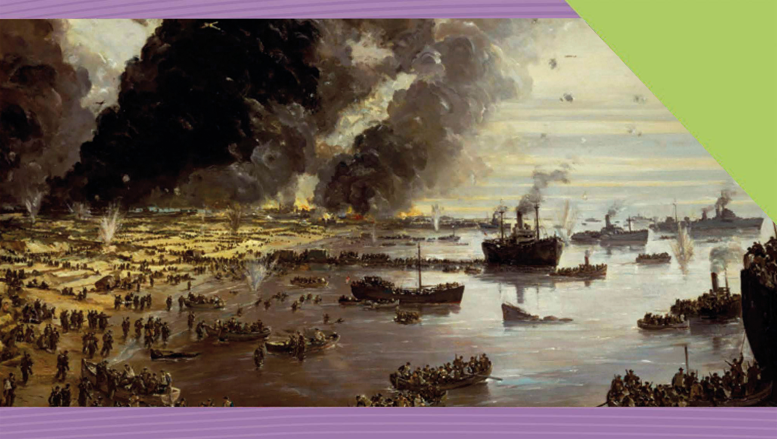
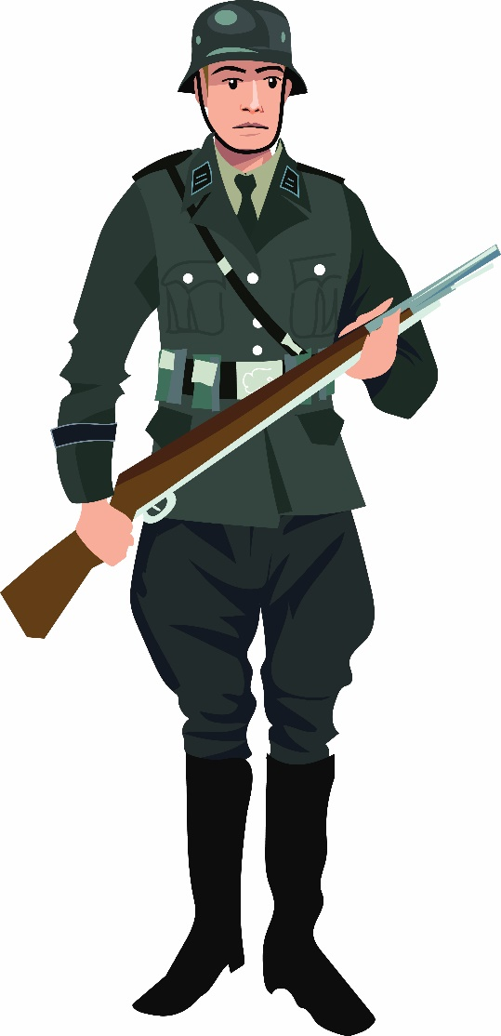

World War II, 1939–45 Course and Impact
19
Making History (2nd Edition)

Slide 2

What Will I Learn?
Discuss the course of World War II
Discuss the immediate and long-term impact of the war on people and nations
Explore the Nature of History

Slide 3
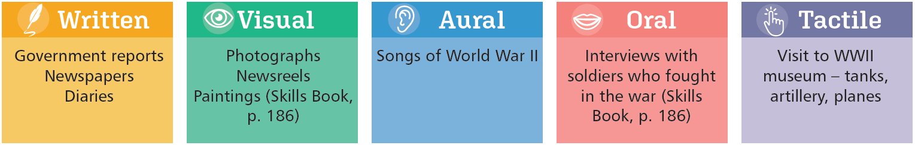
Sources for World War II

Slide 4
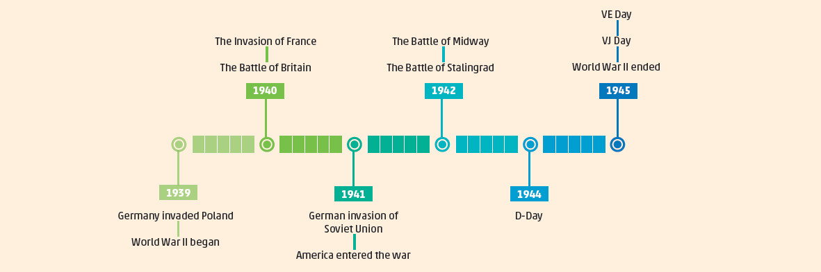
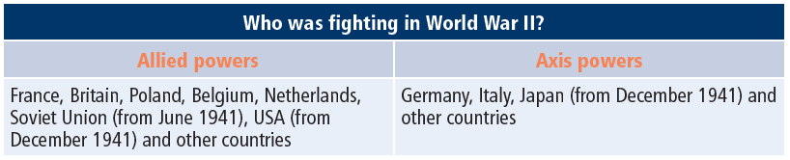
Timeline of World War II, 1939-45

Slide 5
Key Words
Allied powers (countries) | the countries that fought together against the Axis powers of Germany and Japan during World War II
Atomic bomb | a very destructive bomb based on nuclear energy
Axis powers (countries) | the countries that fought against the Allied powers of Britain, France, USA and the Soviet Union
Blitz | German bombing of British cities after the Battle of Britain during World War II
Blitzkrieg | lightning war tactics used by Germany in World War II, using planes, tanks and infantry
D-Day | Operation Overlord – the Allied invasion of Normandy in World War II
Evacuation | moving people out of where they live, sometimes for safety
Nuclear war | a war fought with atomic and hydrogen (nuclear) bombs
Panzer | German tank during World War II
Phoney War | name given to time early in World War II where there were no military operations or fighting on the borders between Germany and France

Slide 6
Key Words
Radar | a system for detecting aircraft and ships by using radio waves which are reflected back from the object
Refugees | people who have fled war, violence, conflict or persecution from their own country to another country
Scorched-earth policy | Russian war tactics during the Second World War to burn crops, destroy bridges and towns as they retreated before the Germans
Superpowers | USA and USSR after World War II, which were the two most powerful countries in the world
Turning point | a time when a decisive event occurs which changes the future

Slide 7
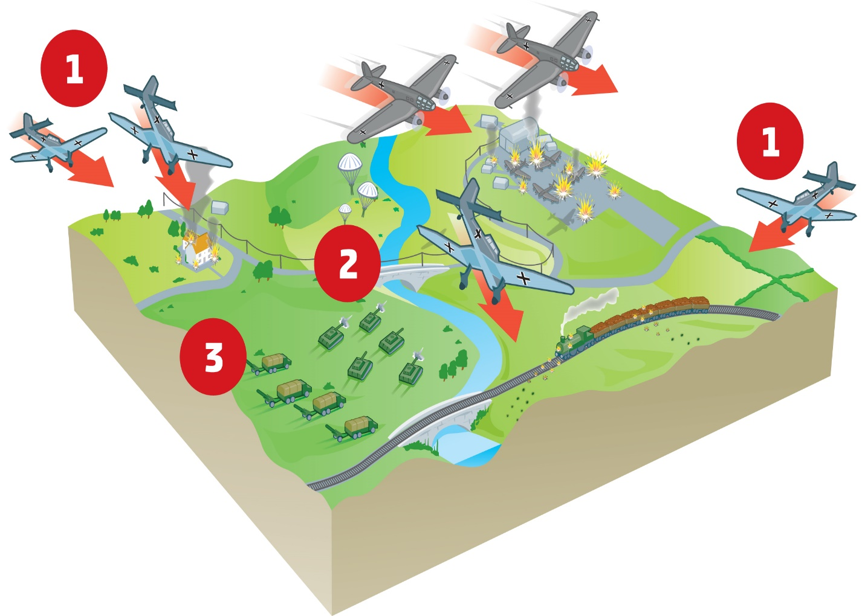
German Victories, 1939–42
The Invasion of Poland, 1939
Blitzkrieg – Speed & surprise
German air force (Luftwaffe) bombers
German panzer (tank) divisions
Motorised German infantry
Poland defeated
Country divided between Germany and the Soviet Union

Slide 8
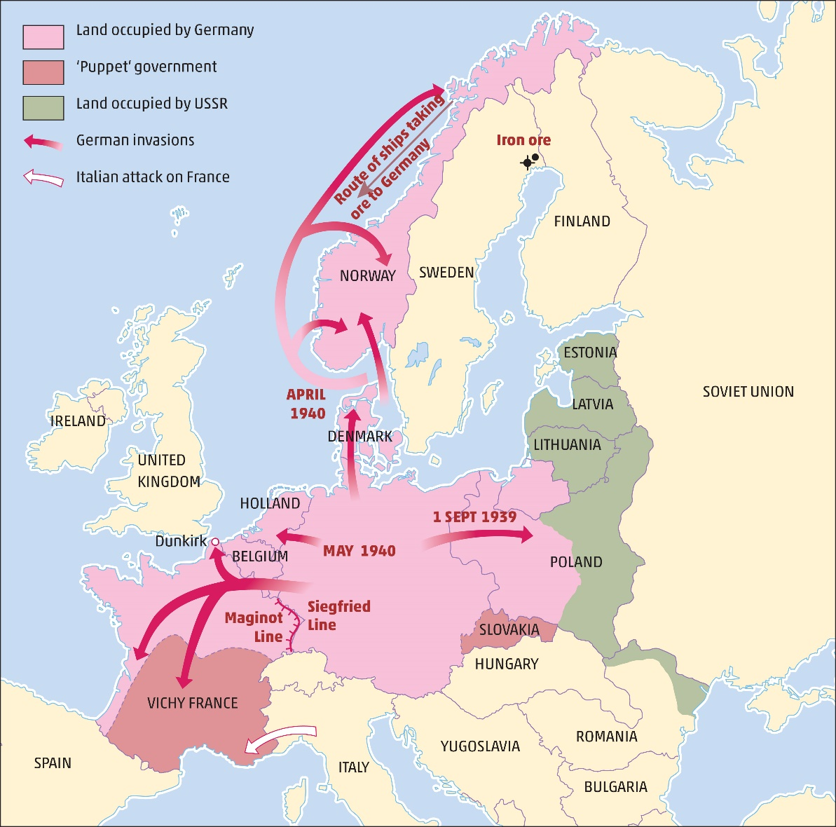
Hitler’s Conquests, 1939–40
1
Poland divided
Phoney War - winter 1939-40
- No fighting on Franco-German border
Denmark and Norway conquered
To secure German iron ore supply from Sweden
Quisling installed in Norway
The Invasion and Fall of France
2
3
4

Slide 9

Assessing Your Learning
Which of the following countries were Axis powers (i) Japan (ii) Germany (iii) France?
What was ‘lightning war’?
Fill in the missing words: ‘The success of Blitzkrieg depended on …… and ……’
Under what pact did Germany and Soviet Russia agree to divide Poland?
What happened during the Phoney War?
Why did Germany attack Denmark and Norway?

Slide 10
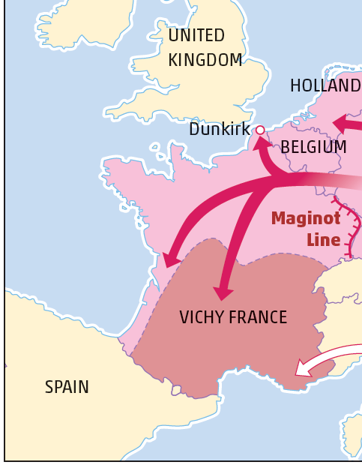
The Invasion of France, 1940
Blitzkrieg tactics
Through Luxembourg
Caught Britain and France by surprise
Pushed back to Dunkirk
Germans easily captured the rest of France and the Maginot Line
France divided in two
Vichy France ruled by French leaders under German control
Rest of France directly under German control

Slide 11
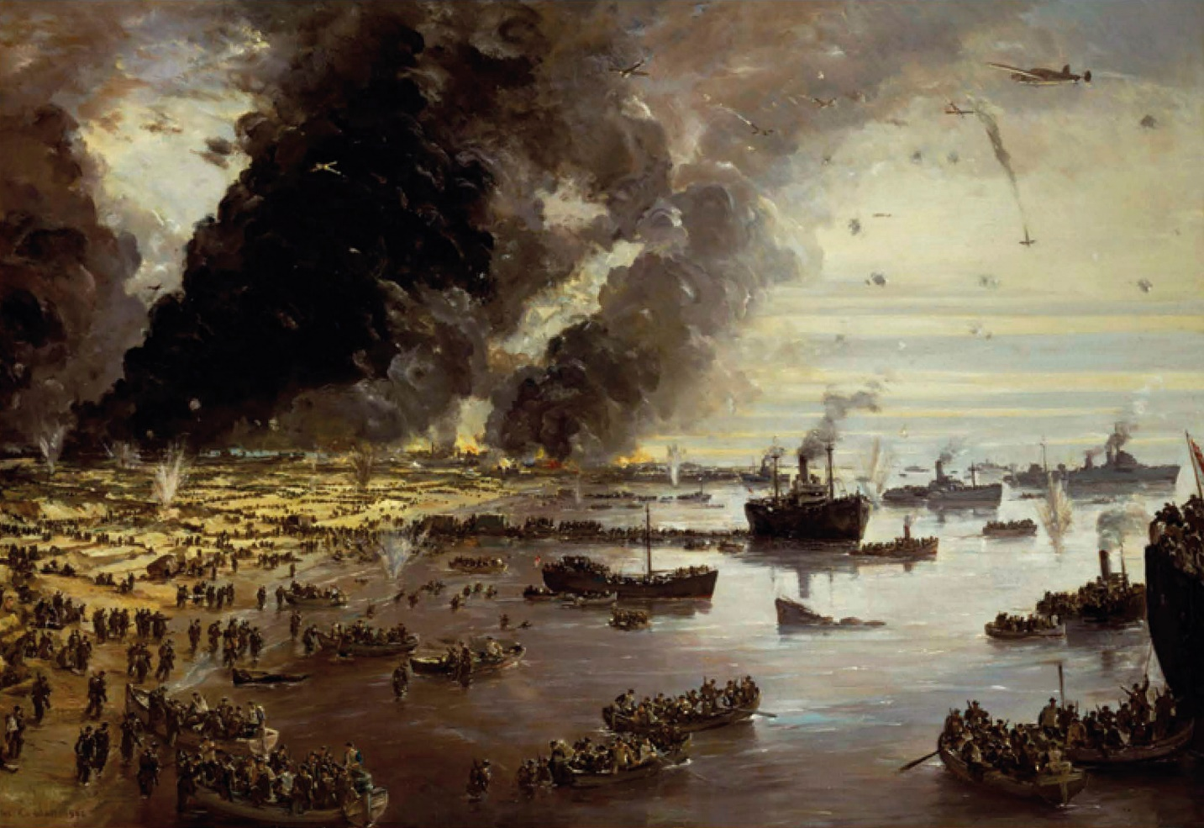
The Invasion of France, 1940
Rescue at Dunkirk
Operation Dynamo
Evacuation of troops
All available British boats
Rescued 300,000 soldiers
Britain highlighted courage of rescuers
The Withdrawal from Dunkirk

Slide 12
Assessing Your Learning
What tactics did Germany use to invade France?
How did Germany catch the British and French armies by surprise?
What was Operation Dynamo?
How did Britain achieve a propaganda victory out of defeat at Dunkirk?
How did Germany capture the rest of France?
What was Vichy France?

Slide 13
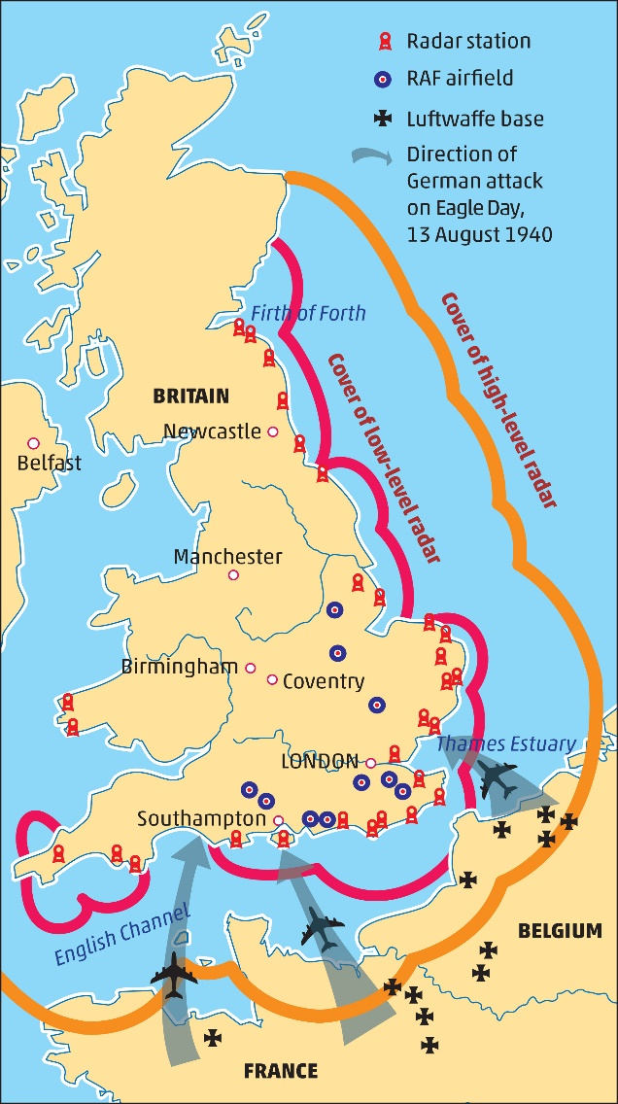
Operation Sea Lion and the Battle of Britain
Operation Sea Lion – German invasion plan
Battle of Britain – to get control of the air
RAF (Royal air Force) V. Luftwaffe (German Air Force)
German attacks on shipping, airfields and radar

Slide 14
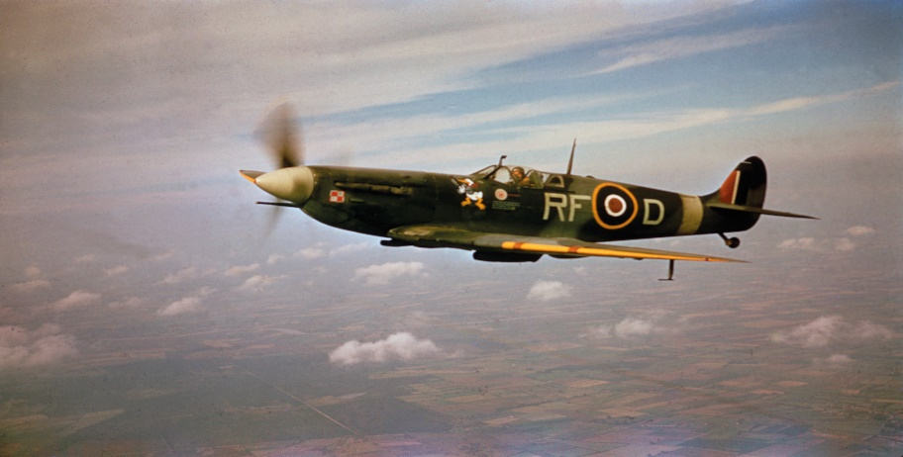
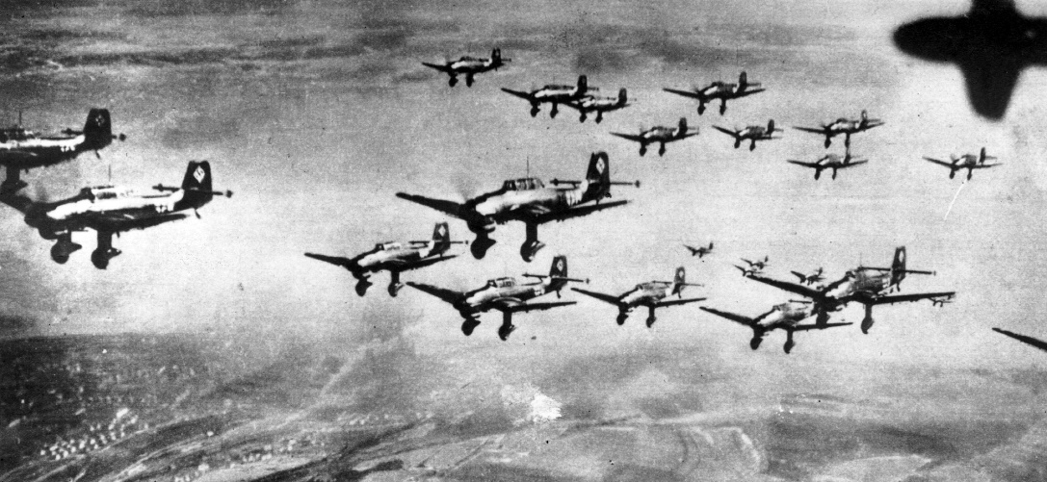
Operation Sea Lion and the Battle of Britain
Spitfires & Hurricanes V. Messerschmitts, Stukas and Heinkels
Advantage of radar – knew when and where the Luftwaffe were going to attack
Hitler postponed the invasion
First defeat
Instead began the Blitz
Spitfire
Stukas

Slide 15
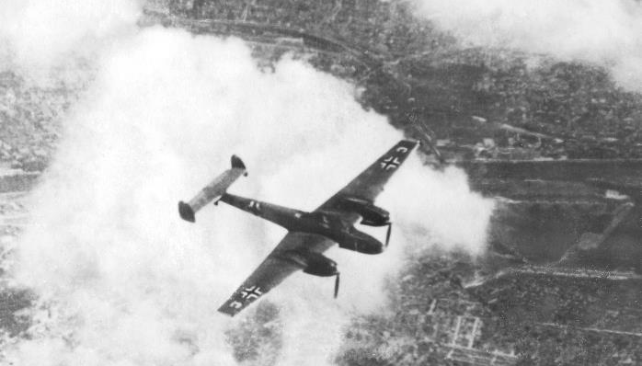
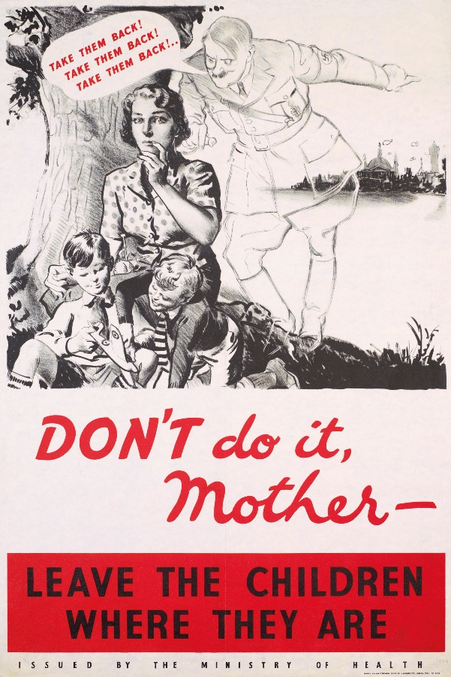
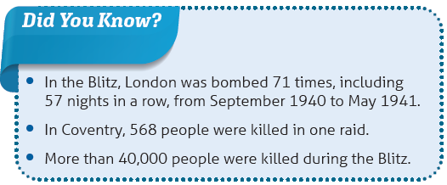
The Blitz
German attack on British cities
Aim – to destroy industries and break the will of the people
Attacks on London, Coventry, Liverpool and Glasgow: Also Belfast
People evacuated to countryside
London Underground used for shelter
Churchill’s leadership boosts morale
Help from US with Lend-Lease Scheme
Hitler stopped the Blitz when planes were needed for the invasion of the Soviet Union (June 1941)
Messerschmitt

Slide 16
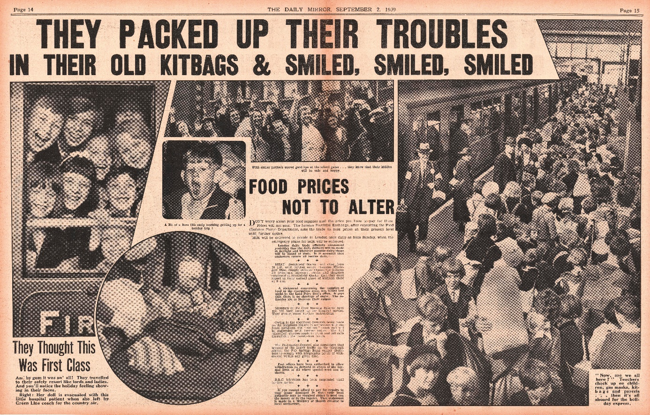
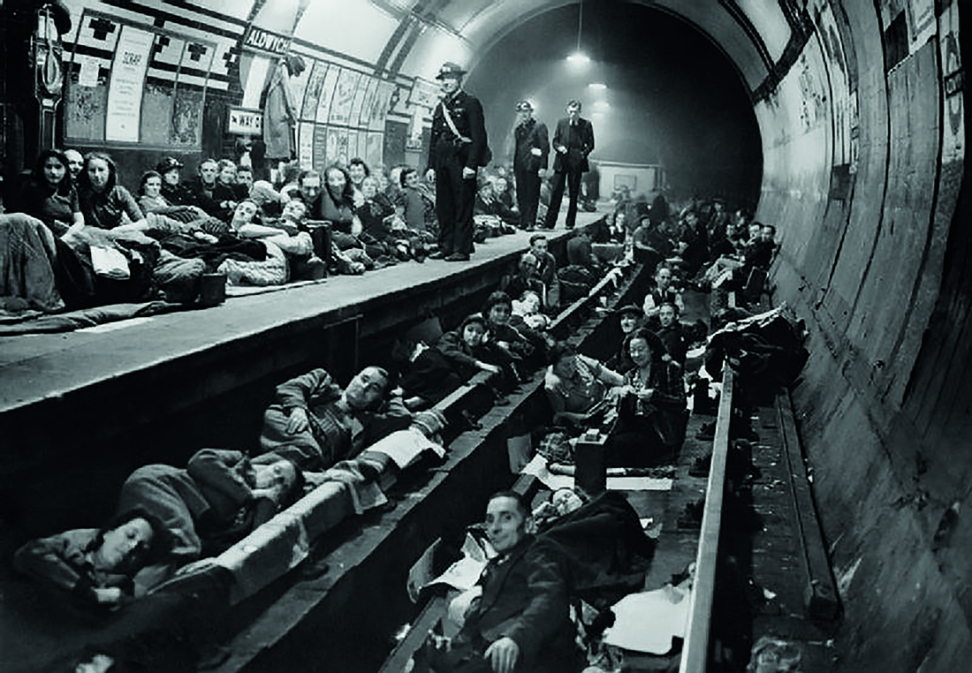
London During the Blitz
Evacuation to the countryside
London Underground for shelter

Slide 17
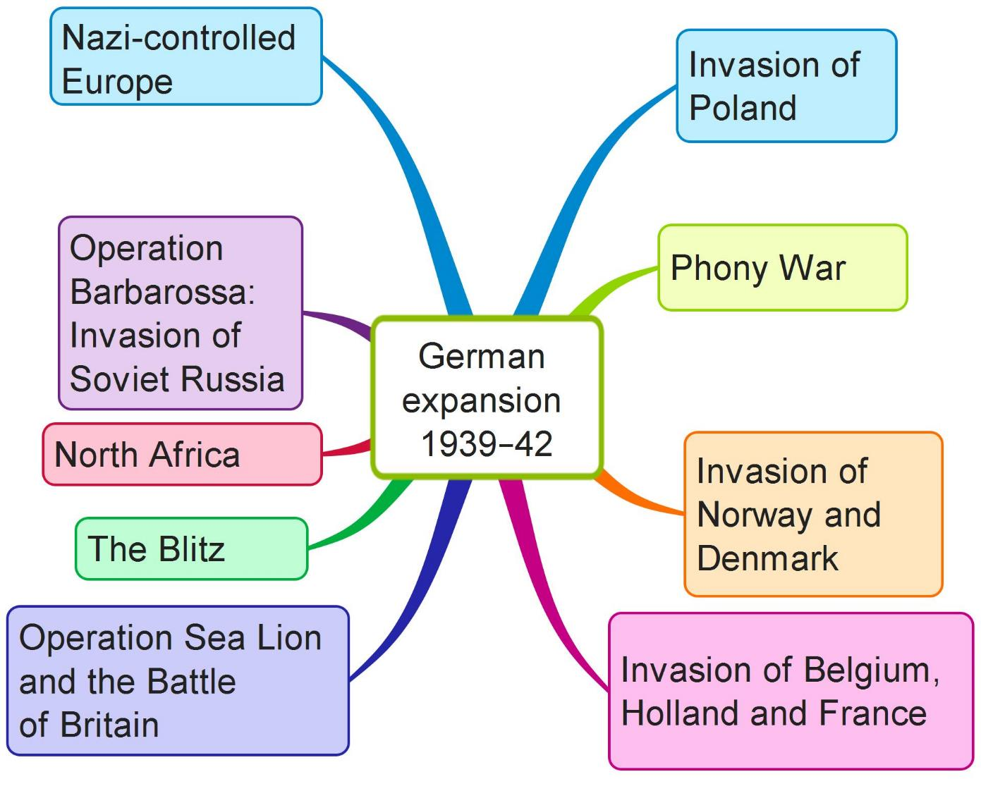
German Expansion
Create your own mind map on German expansion, 1939–42 using the above features

Slide 18
Assessing Your Learning
Who became prime minister of Britain during the German invasion of France?
What was Operation Sea Lion?
Why did Hitler have to gain control of the skies over the English Channel?
What two air forces were involved in the Battle of Britain?
Name one plane used by each air force.
How did radar help Britain?
Why did Hitler put off the invasion of Britain?
What was the Blitz?
Why were cities attacked during the Blitz?
Why did Hitler stop the Blitz?
What was the Lend-Lease scheme?

Slide 19
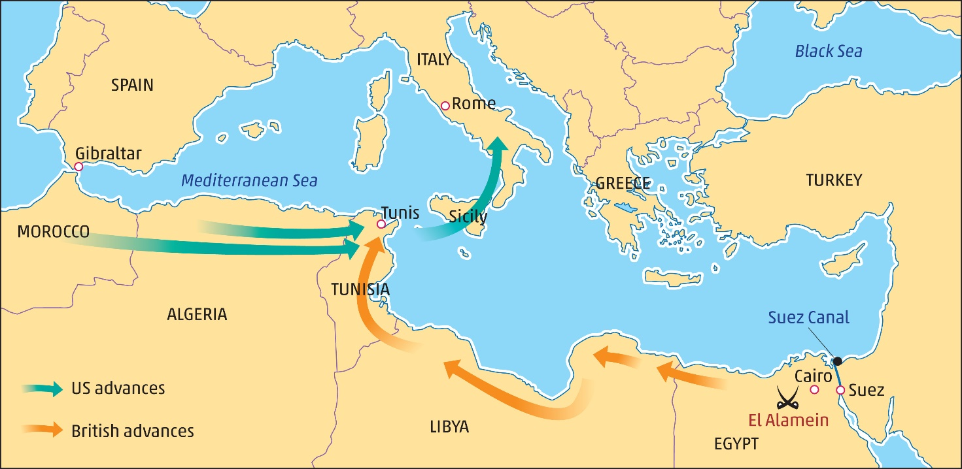
The Allies Turn the Tables, 1942–45
The Desert War in North Africa
Mussolini joined Hitler
Mussolini’s army in Libya helped by Rommel’s Afrika Corps
Aim: to capture the Suez Canal, Britain’s shorter route to India and the Far East
Defeated at Battle of El Alamein by Montgomery
A turning point in the war
Italians and Germans retreated
The progress of the British and American armies after the defeat of Rommel by Montgomery at the Battle of El Alamein

Slide 20
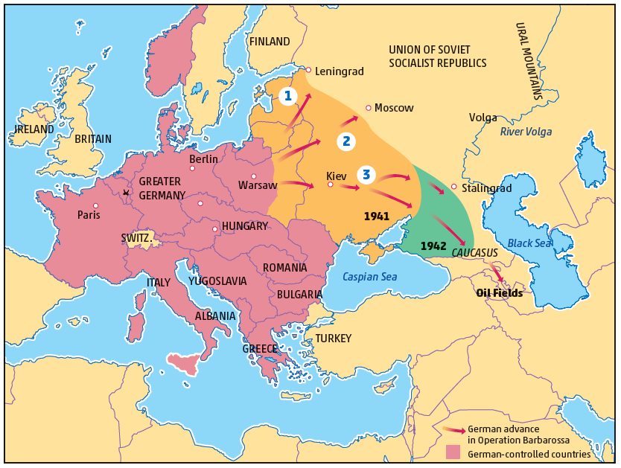
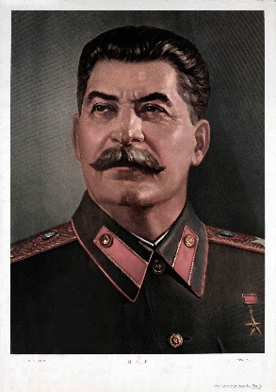
Operation Barbarossa: The Invasion of Soviet Russia, 1941
German attack on the Soviet Union
Aim – to destroy communist enemy and gain lebensraum; also oil & gas in the Caucasus
Three-pronged attack
Use of blitzkrieg tactics
Stalin and Great Patriotic War
Moved heavy industry east of the Urals
Use of scorched earth policy
Impact of Russian winter
Battle of Stalingrad – a turning point
Stalin

Slide 21
Assessing Your Learning
Why did Hitler send Rommel to North Africa?
Who fought in the Battle of El Alamein?
Why was that battle a turning point in the war?
What was Operation Barbarossa?
What was the three-pronged attack made by the Germans on Soviet Russia?
What role did Stalin play in the war?
What was the scorched-earth policy?
Why was the Battle of Stalingrad a turning point in the war?

Slide 22
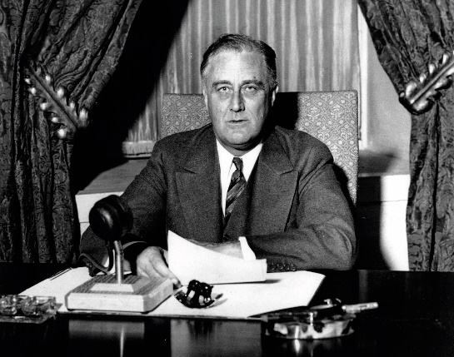
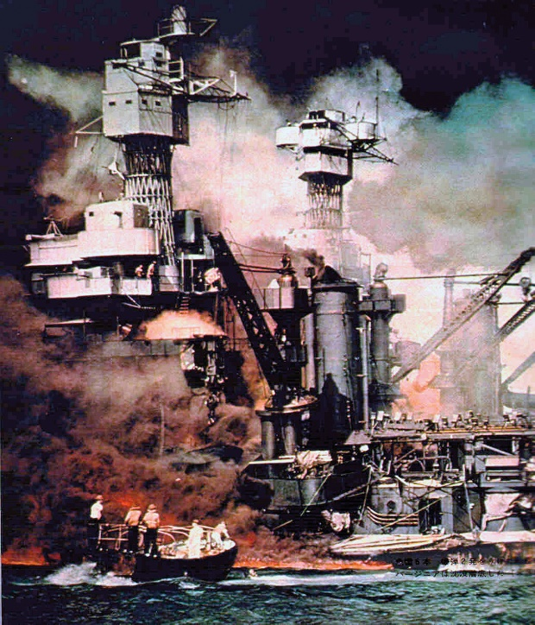
America Joined the War – A Turning Point
Japanese bombing of Pearl Harbour in Hawaii
Main part of US fleet escaped
Hitler declared war on America
US entry to WWII – a major turning point in the war
Roosevelt
Damage at Pearl Harbour

Slide 23
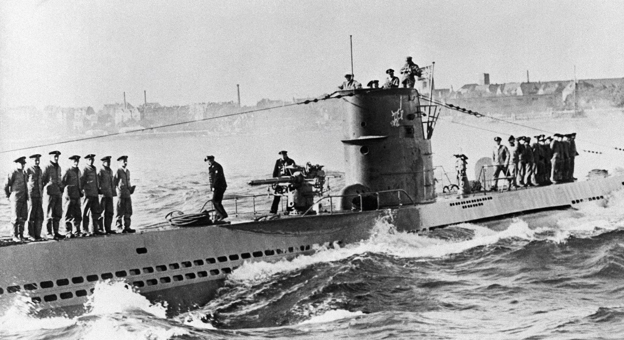
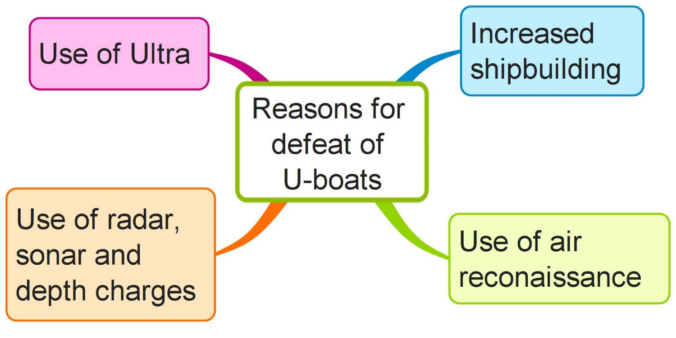
The War at Sea: The Battle of The Atlantic
America the ‘arsenal of democracy’
American supplies to Britain
Supplies also from Commonwealth countries
German wolfpack attacks
Allied use of convoys
Allies won the war at sea – why?
Another turning point in the war
German U-boat

Slide 24
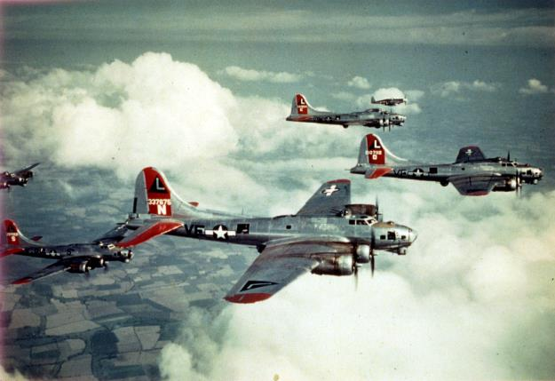
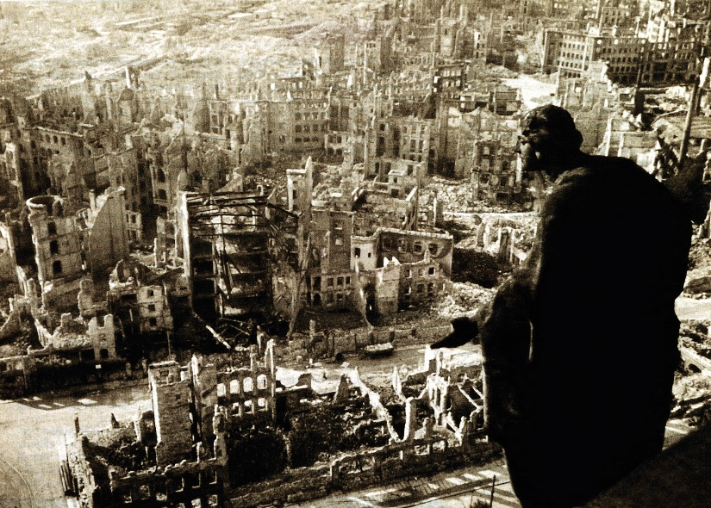
War in the Air
Bombing raids on German cities, e.g. Hamburg, Berlin, industrial cities of Ruhr, Dresden
War production disrupted
Flying Fortresses, Lancaster bombers
German use of V1 flying bombs, V2 rockets
Too late in the war
Allies won the war in the air
Another turning point in the war
American Flying Fortresses
Destruction of Dresden

Slide 25
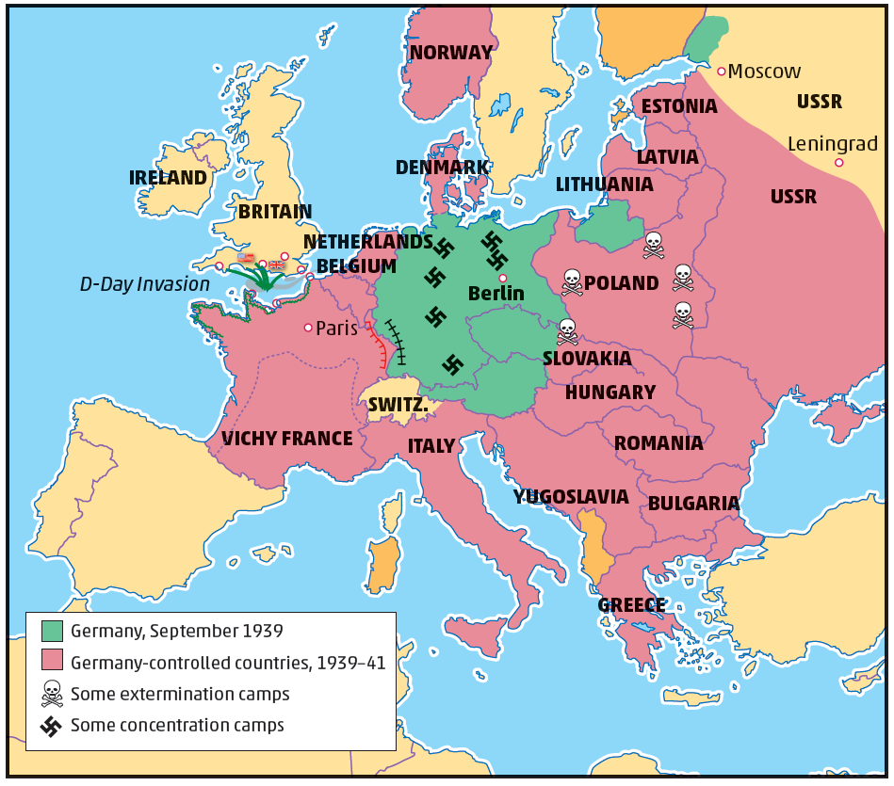
Nazi-Controlled Europe
SS and Gestapo enforced Nazi-rule
7.5 million foreign workers used as slave labour
Hitler’s Final Solution – plan to eliminate Jews
6 million Jews killed in the Holocaust
Some active resistance to Hitler and Nazis in certain countries – spying, sabotage, ambushes
Most of the continent of Europe had been conquered by Germany and its allies by 1942

Slide 26
Assessing Your Learning
What happened at Pearl Harbour in December 1941?
Why was the US entry into the war another turning point?
Why was the US called the ‘arsenal of democracy’?
Explain ‘U-boats’ and ‘wolfpacks’.
How serious were the U-boat attacks on Allied shipping?
Give one way the Allies turned the tables on the German submarines.
How successful was the Allied bombing of Germany?
What were ‘V1’ and ‘V2’?
How did the Nazis control the lands they conquered?

Slide 27
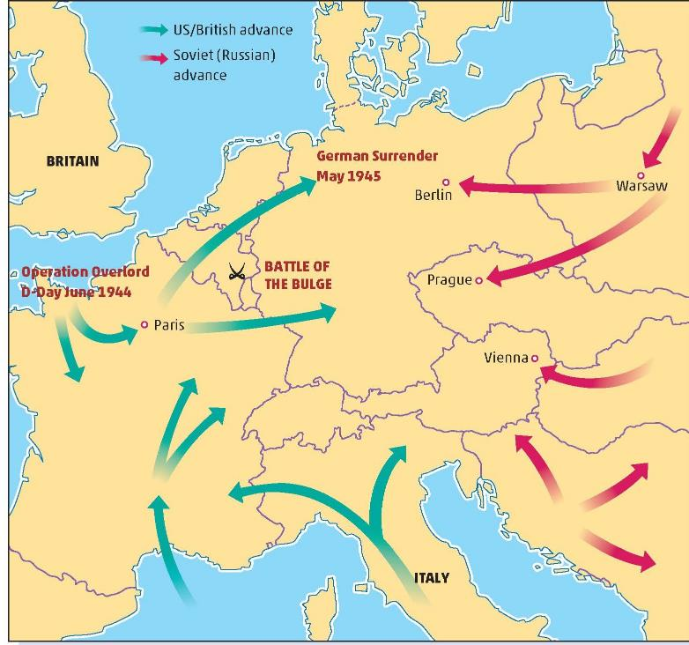
The Allies Advance, 1942–45
Americans and British advance through Italy
Mussolini captured and killed
Americans and British invaded France on D-Day
Soviet army advanced from east
Battle of Kursk – largest tank battle in the war
Advanced to Warsaw
Refused to help Warsaw Uprising
Poles crushed

Slide 28
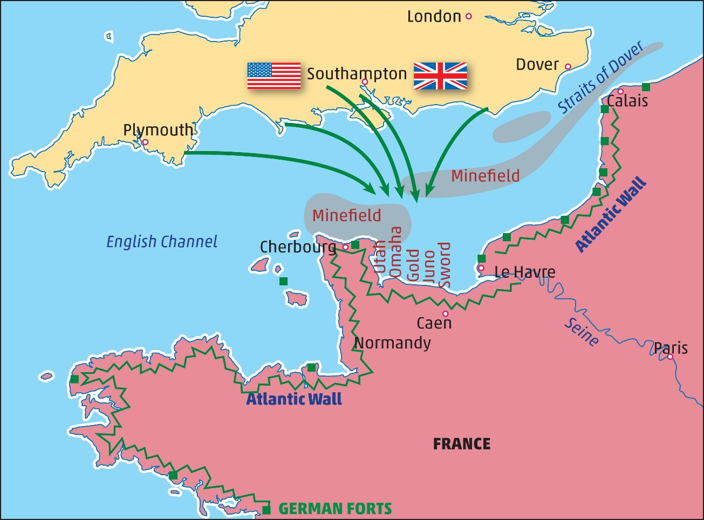
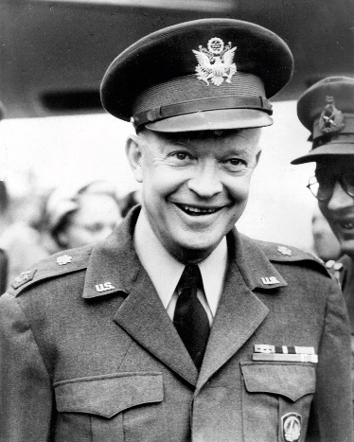
D-Day, June 1944
Normandy coast – why?
Surprised Germans
Eisenhower, commander
Planes bombed Atlantic Wall
Paratroopers dropped
Invasion fleet on 5 beaches
Utah, Omaha, Gold, Juno and Sword
Beachheads
Mulberry piers
PLUTO
Advance to Paris and Battle of the Bulge
Eisenhower

Slide 29
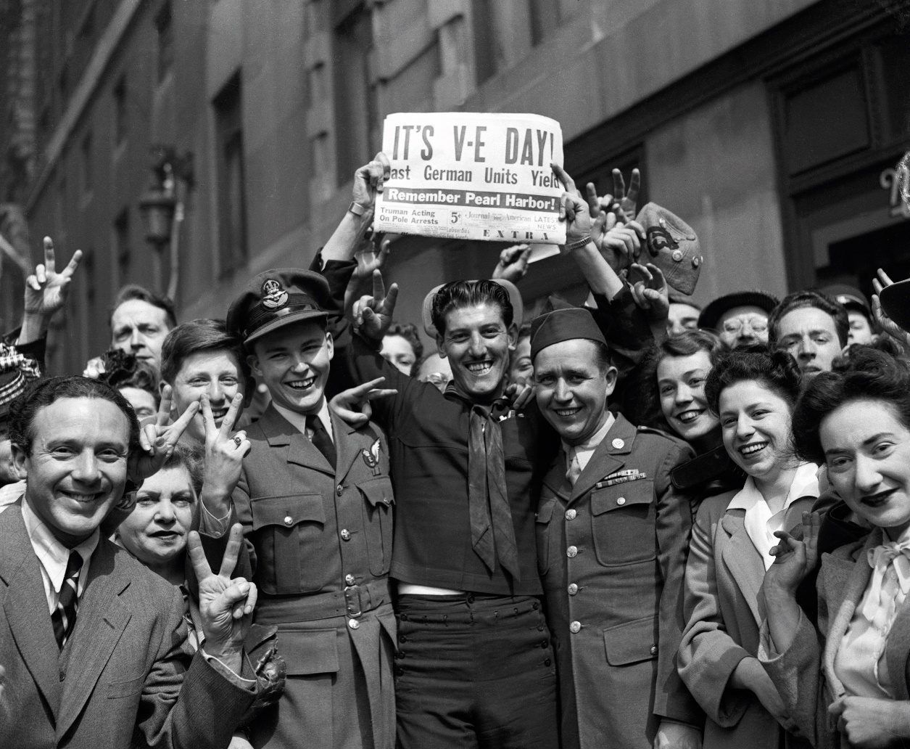
Hitler’s Suicide – The End of War in Europe
Trapped in bunker in Berlin
Hitler, Eva Braun and close followers committed suicide
Germany surrendered unconditionally
VE Day, 8 May 1945

Slide 30
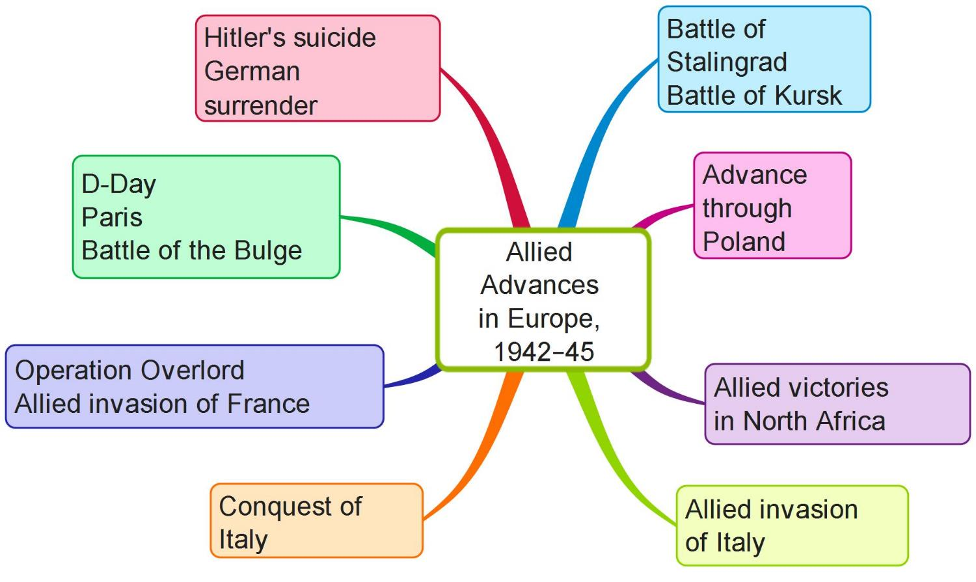
Allied Advances
Create your own mind map on Allied advances in Europe, 1942–45 using the above features

Slide 31
Assessing Your Learning
What Allied countries advanced against Germany from (i) the south and (ii) the east?
Who won the Battle of Kursk?
What did the Soviet Army do during the Warsaw Uprising?
What was Operation Overlord?
Who commanded the Allied invasion force for D-Day?
Name two of the code names for the landing beaches for the Allied invasion.
What were (i) mulberry piers and (ii) Pluto?
How did Hitler die?

Slide 32
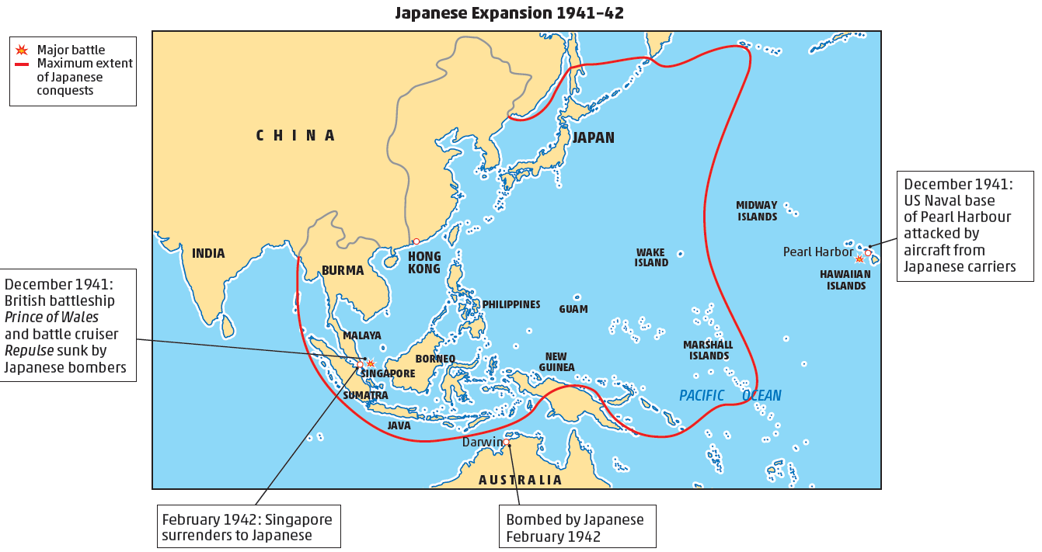
The War in the Far East
Japanese attack on Pearl Harbour
Japanese conquest of islands in Pacific Ocean
Japanese captured Singapore
Danger to Australia
Now a global war

Slide 33
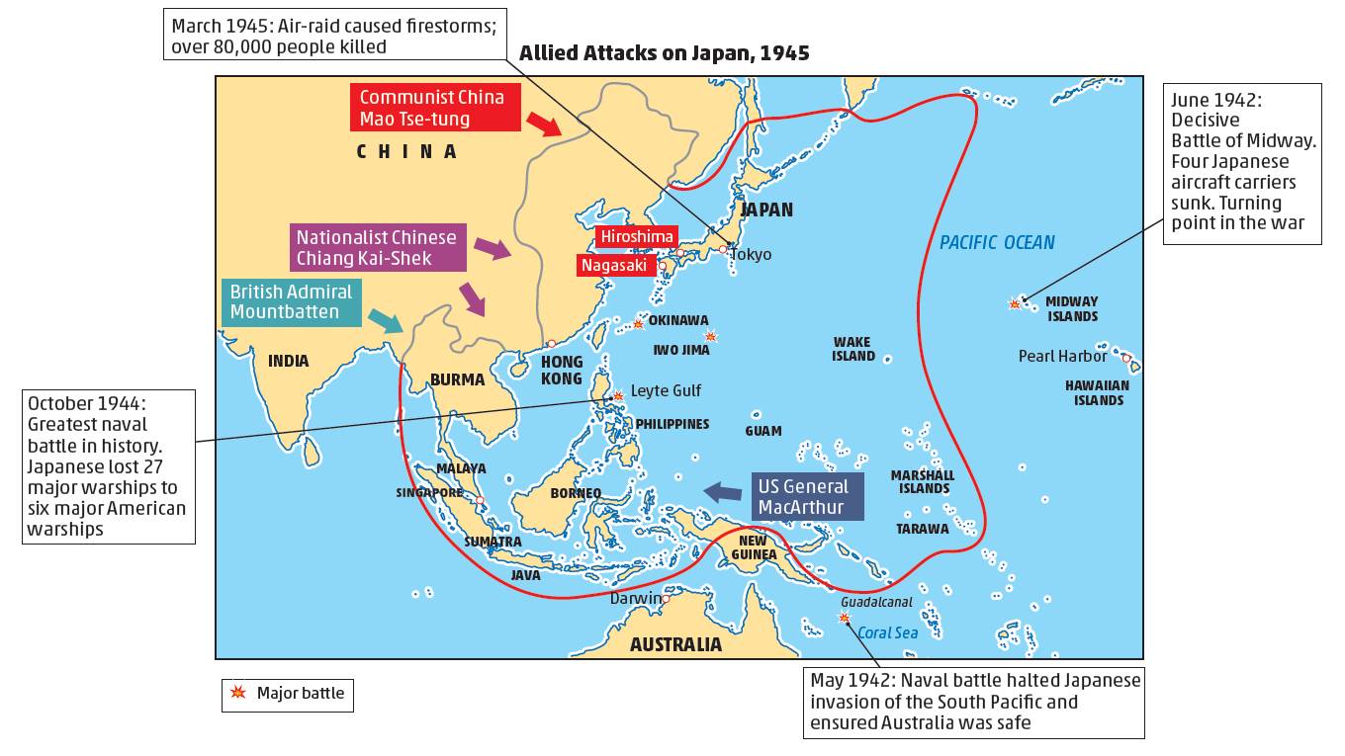
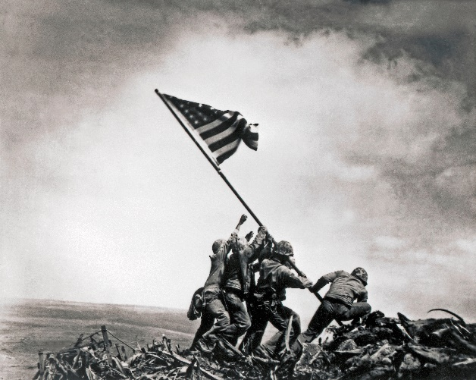
Turning Point in the Pacific War
US Navy defeated Japanese Navy in Battle of Midway
A turning point in the war
Now Americans advance
Major sea battles
Battle of the Coral Sea
Battle of Leyte Gulf
Battle of Iwo Jima
Atomic bombs on Hiroshima and Nagasaki
Japan surrendered
VJ Day celebrated
Iwo Jima

Slide 34
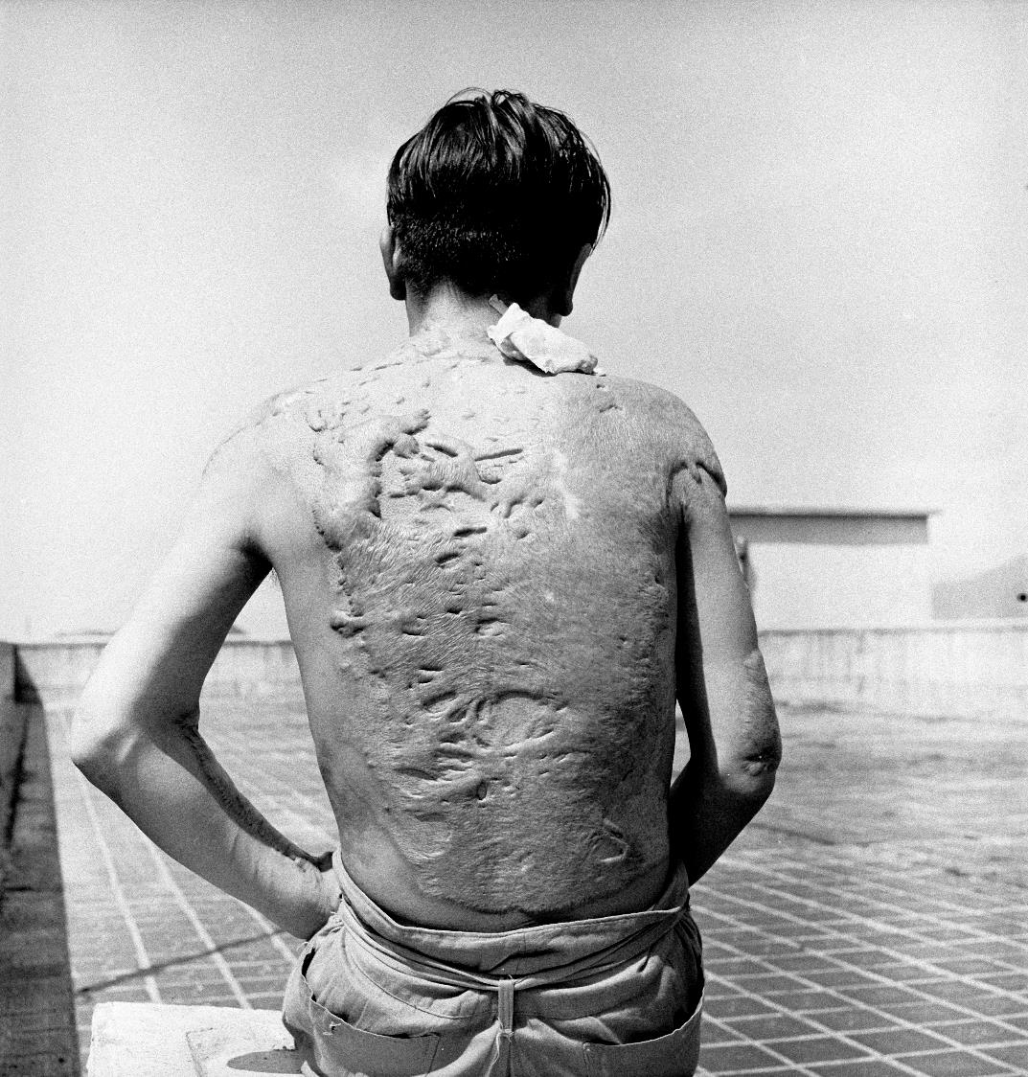
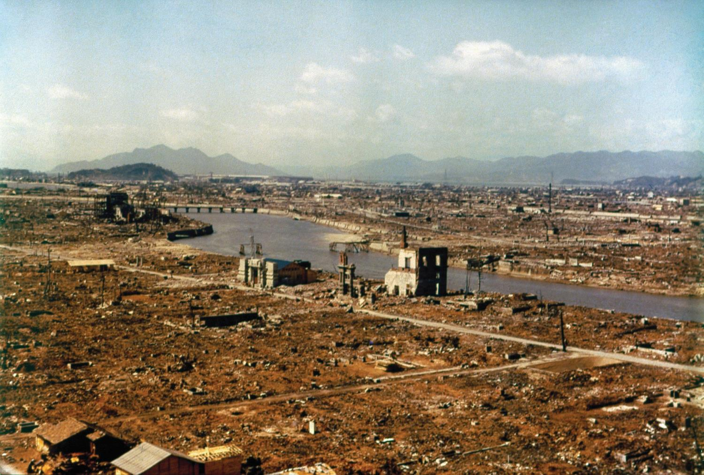
Should the Atomic Bombs have been Dropped on Hiroshima and Nagasaki?
Hiroshima after the atomic explosion, August 1945
A victim of the Hiroshima explosion

Slide 35

Should the Atomic Bombs have been Dropped on Hiroshima and Nagasaki?
Source 1
The total strength of the Japanese army was estimated at about 5 million men. The air force or Kamikaze, or suicide attacks had already caused serious damage to our seagoing forces. There was a very strong possibility that the Japanese government might decide on resistance to the end. The Allies would have been faced with the enormous task of destroying an armed force of five million men and five thousand suicide aircraft. We estimated that if we were forced to carry this plan to its conclusion, the major fighting would not end until the latter part of 1946 at the earliest.
Henry Stimson, the US Secretary of State for War in 1945, writing in 1947
Source 2
The Americans dropped atom bombs on the Japanese cities of Hiroshima and Nagasaki killing hundreds of thousands of civilians. Officially the USA ‘claimed’ that the bombings were aimed at bringing the end of the war nearer and avoiding unnecessary casualties. But they had entirely different reasons. The purpose of the bombings was to intimidate other countries, above all the Soviet Union.
Vadim Nekrasov, The Roots of European Security (1984), a Russian history book
Source 3
On the first day of July (1945), Sato (the Japanese Ambassador in Moscow) sent a long message to Tokyo. He strongly advised accepting any terms. The response of the Japanese Cabinet (government) was that the war must be fought with all the energy that the nation was capable of so long as the only alternative was unconditional surrender.
A Japanese telegram intercepted by US Intelligence in 1945
What do these sources say about the reasons for dropping the atomic bombs?

Slide 36
Assessing Your Learning
After attacking Pearl Harbour, where did Japan capture an important British naval base?
Why was the Battle of Midway an important turning point in the war?
What other two countries besides Britain and the US advanced on Japan?
On what two Japanese cities did the US drop atomic bombs?
What was the impact of those bombs?
Explain ‘VE Day’ and ‘VJ Day’.

Slide 37
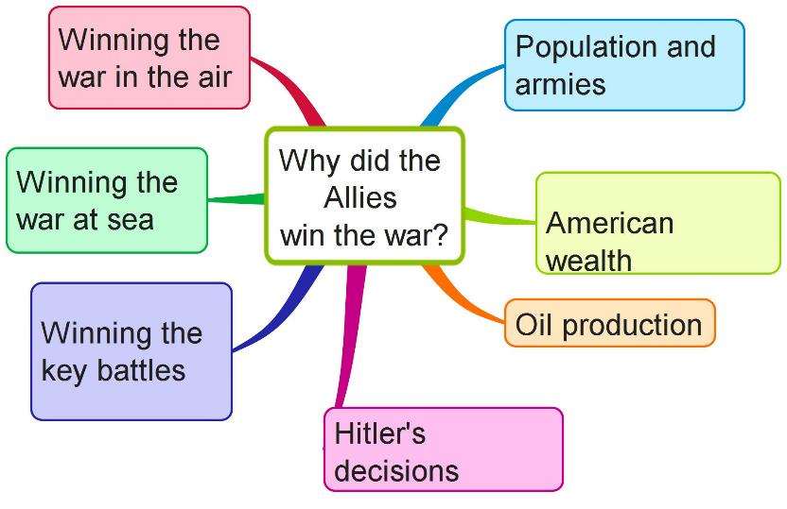
Why Did the Allies Win the War?
Create your own mind map on Why the Allies won the war using the above features and p. 320-21

Slide 38
Assessing Your Learning
Select three reasons why the Allies won the war and explain them.
Which of the reasons explaining why the Allies won the war was the most important? Explain your answer.

Slide 39
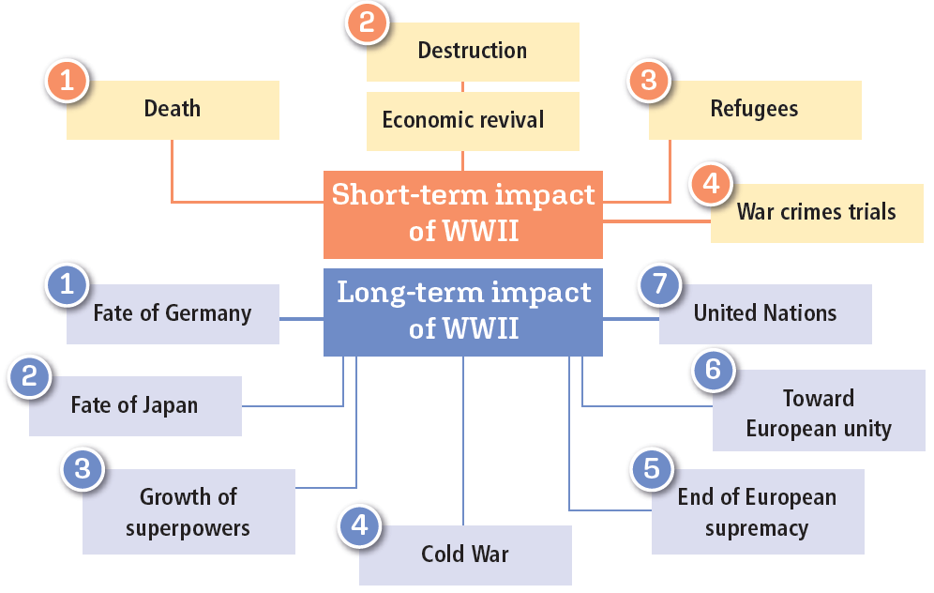
What was the Impact of World War II?

Slide 40
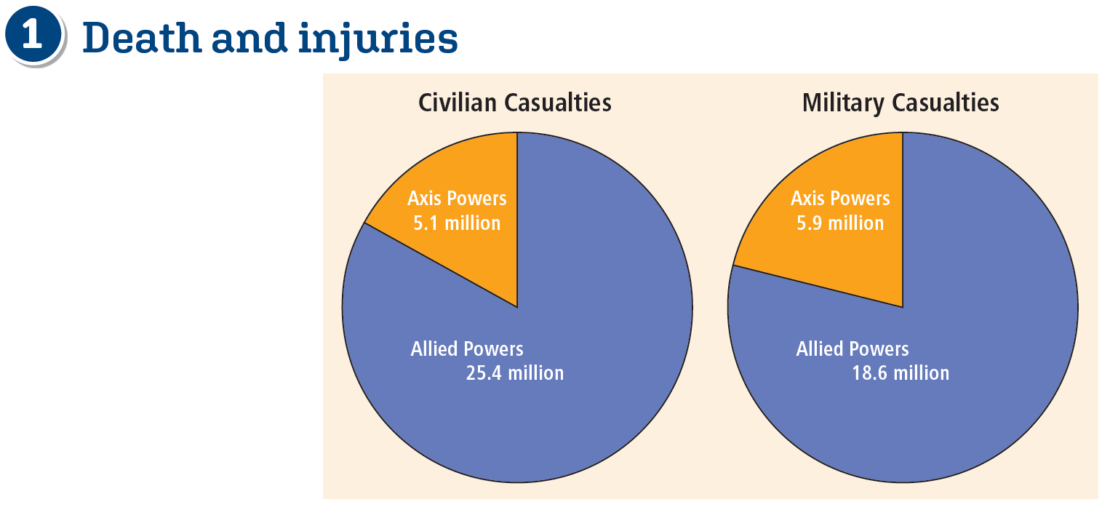
Short-Term Impact

Slide 41

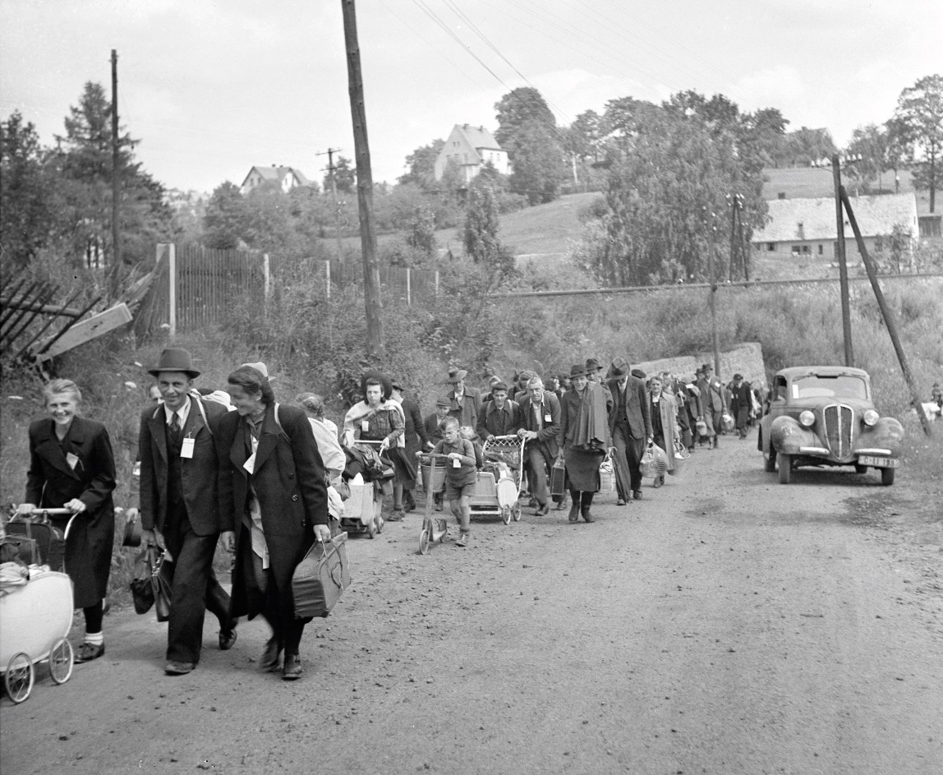

Destruction and Economic Revival
Cities, industries, roads, railways, harbours
Marshall Aid to European governments
American control of Japan
Improved the Japanese economy
Also later impact of Korean War on Japan
Refugees
11.5 million Germans moved from Eastern Europe
Jews leaving concentration camps
Some moved to Israel
Poles moved from land given to Soviet Union

Slide 42

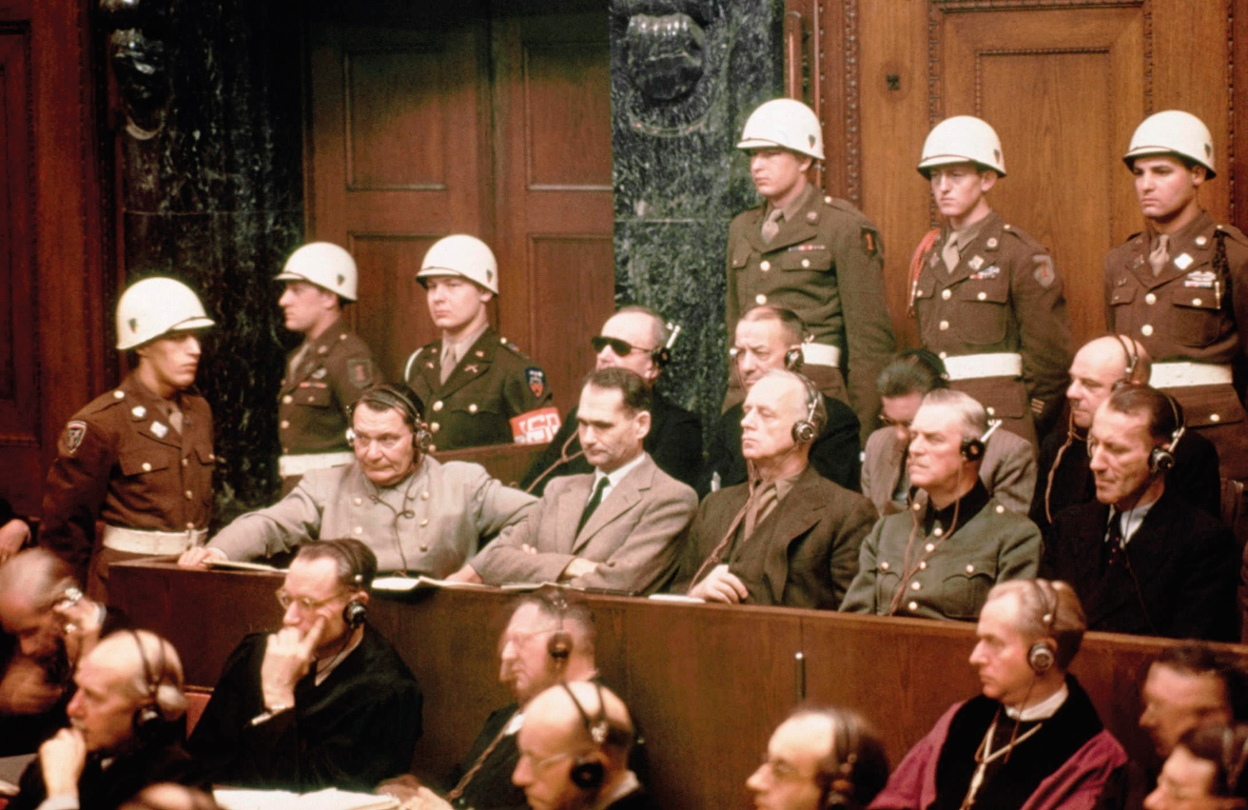
War Crimes Trials
Nuremberg Trials of high-ranking Nazis for war crimes
Tokyo Trials of Japanese leaders
Nuremberg Trials

Slide 43
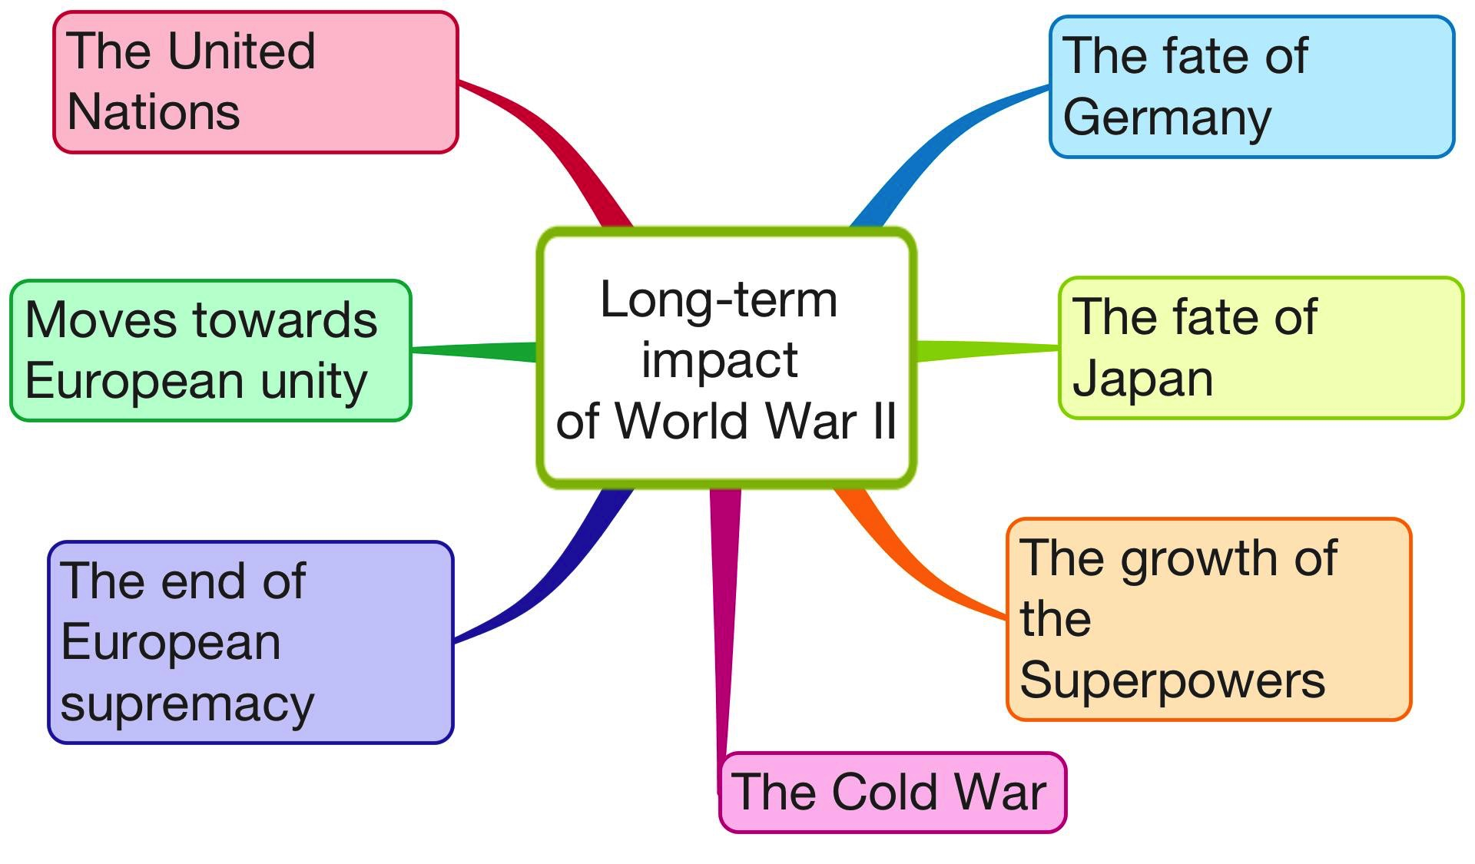
Long-Term Impact
7
1
6
2
5
3
Create your own mind map on the long-term impact of World War II using the above features and p. 323
4

Slide 44
Assessing Your Learning
Were there more civilian or military casualties in World War II?
Why was there so much destruction of cities, industries, roads, railways and harbours during World War II?
How did economies in Europe and Japan revive after the war?
Why was there a huge movement of people after the war?
Where were the war crime trials of (i) German leaders (ii) Japanese leaders held after the war?
How was (i) Germany (ii) Berlin divided after the war?
Who were the superpowers?
What was the Cold War?
Why did European empires decolonise after the war?
How did World War II lead to (i) the movement for European unity and (ii) the founding of the United Nations?

Slide 45
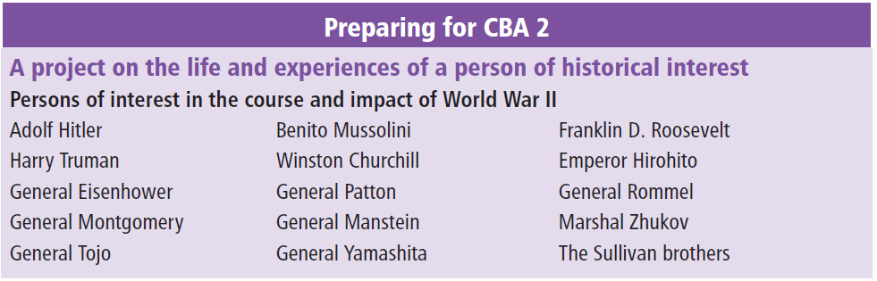
Preparing for CBA 2

Slide 46
